Slide 1
Interactive Virtual Assistance using Projected Augmentation

Slide 2
Group Members:
Pratish Jain (60003130016)
Soham Mehta (60003130028)
Aayushi Vora (60003148015)

Slide 3
Problem Definition
We propose to use the concept of augmented reality for educational purpose-AR Books.
AR Books have the educationally positive effects on not only cognitive but also affective domains such as engagement, presence, interactivity and affordance.
In case of Electrical circuit the AR book will identify the circuit by means of a marker and related explaination will be provided.

Slide 4
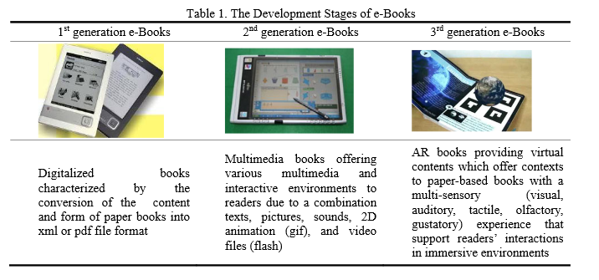

Slide 5
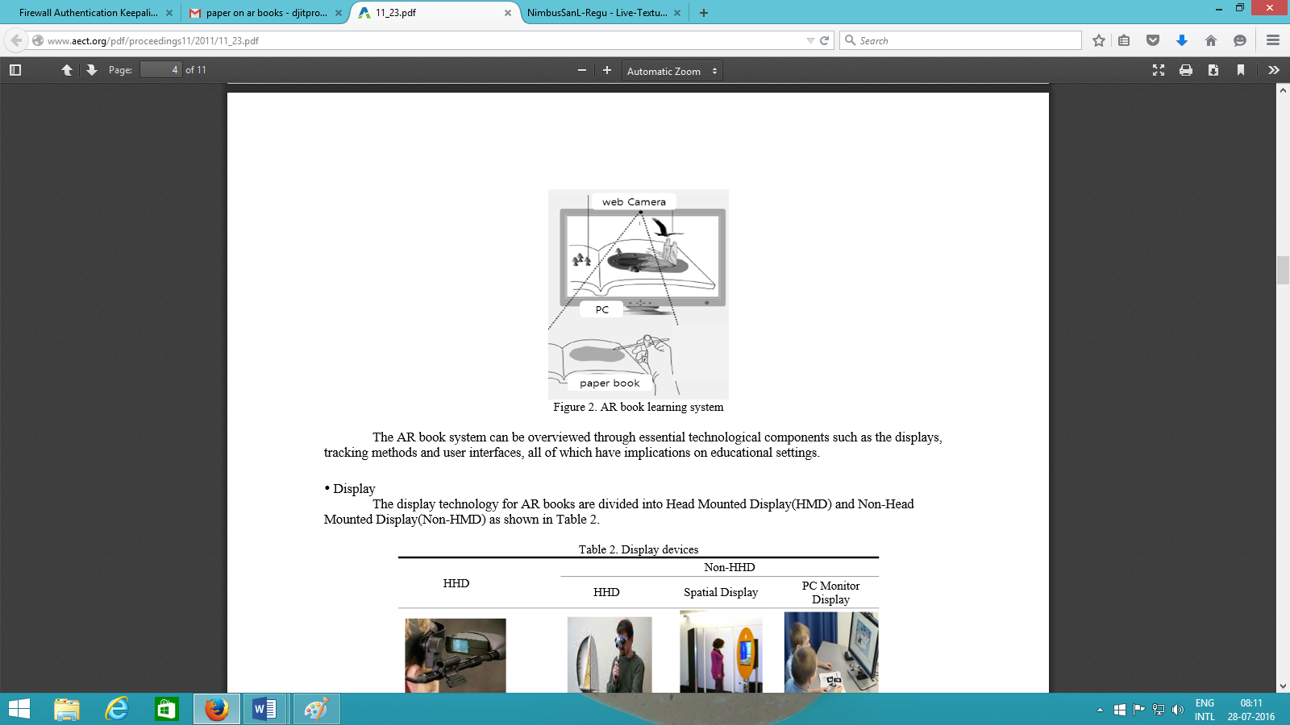
Usage & Applications
Education
Restaurant Menu cards
Technical and Professionals Books
Newspaper Advertisements
Touristic Guides.

Slide 6
Scope
AR books have appeared as an attempt to apply AR to the e-Book format.
AR books have enhanced the concept of books by creating interactive environment that incorporates animation and 3D graphics.
AR books also have augmented physical paper books with 3D objects, video, voice, and multimedia elements generated by computer graphics using AR technology.

Slide 7
Existing System Study
wARna
wARna is a mobile-based Augmented Reality colouring book that extracts texture from the colouring book to be mapped onto the corresponding 3D content and employs marker-based detection in the form of frame marker for the augmentation part.
This system is used for 3D modelling of the textures and coloring the objects.
How the system works? 1: Marker Registration and Detection- Uses ‘frame marker’ in Qualcomm AR library 2: Texture Extraction and Processing-Uses computer vision library such as OpenCV 3: Texture Mapping-Uses the technique of UV mapping

Slide 8
Tools
Product | Company | License | Supported Platforms
ARPA SDKs | Arpa Solutions | Commercial* | Android, iOS (ARPA SDKs), Google Glass (ARPA GLASS SDK), Android, iOS, Windows PC (ARPA Unity Plugin)
ARLab SDKs | ARLab | Commercial | Android, iOS
DroidAR | – | Free and Commercial | Android
Metaio SDK | Metaio | Free and Commercial | Android, iOS, Windows PC, Google Glass, Epson Moverio BT-200, Vuzix M-100, Unity
Vuforia SDK | Qualcomm | Free and Commercial | Android, iOS, Unity
Wikitude SDK | Wikitude GmbH | Commercial* | Android, iOS, Google Glass, Epson Moverio, Vuzix M-100, Optinvent ORA1, PhoneGap, Titanium, Xamarin

Slide 9
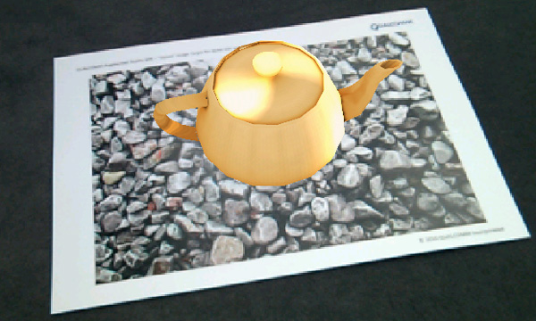
Technologies
Vuforia in Unity 3D:
Image target Detection: Do not need special black and white regions or codes to be recognized.
Device Database
Cloud Database
User Defined Targets
Cloud Recognition

Slide 10
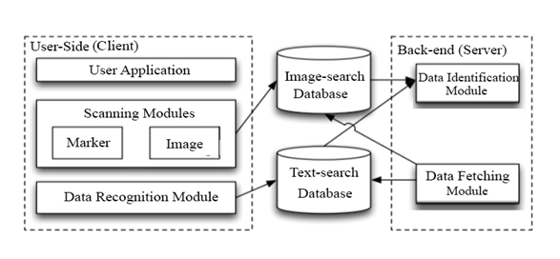
Architecture

Slide 11
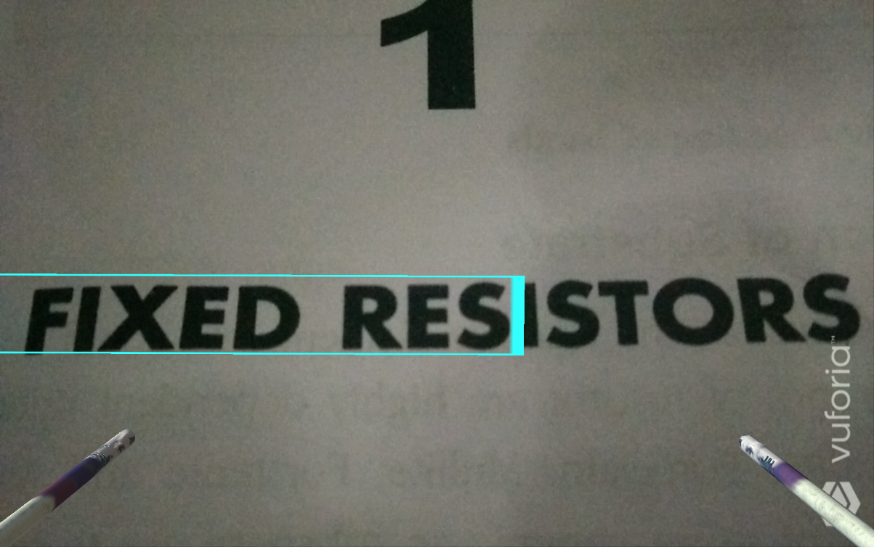
Results
Content Identification

Slide 12
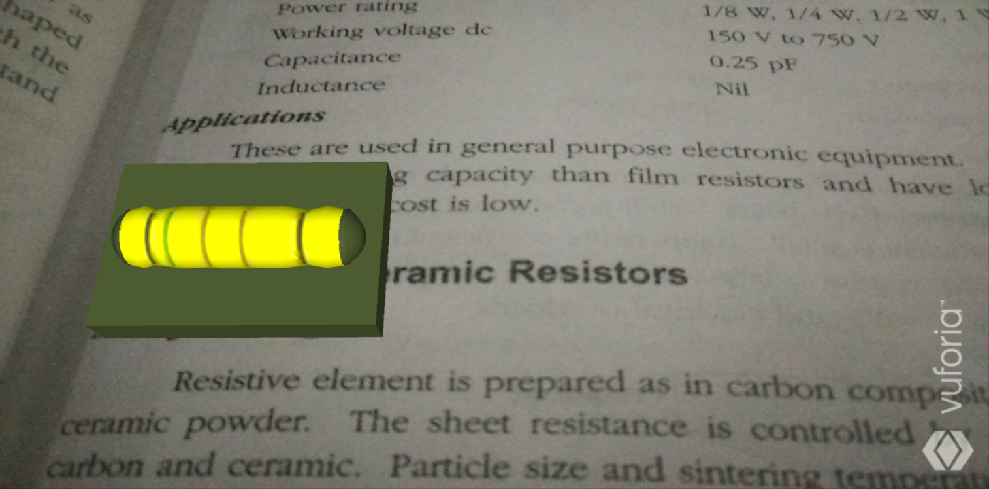
3D Model Augmentation

Slide 13
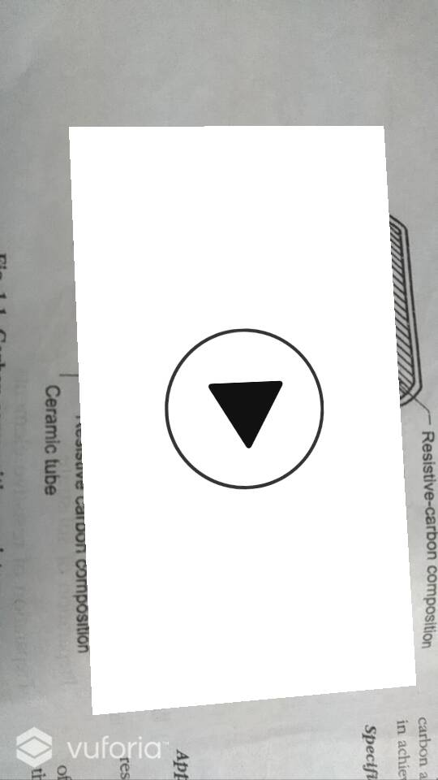
Media Content shown on hovering

Slide 14
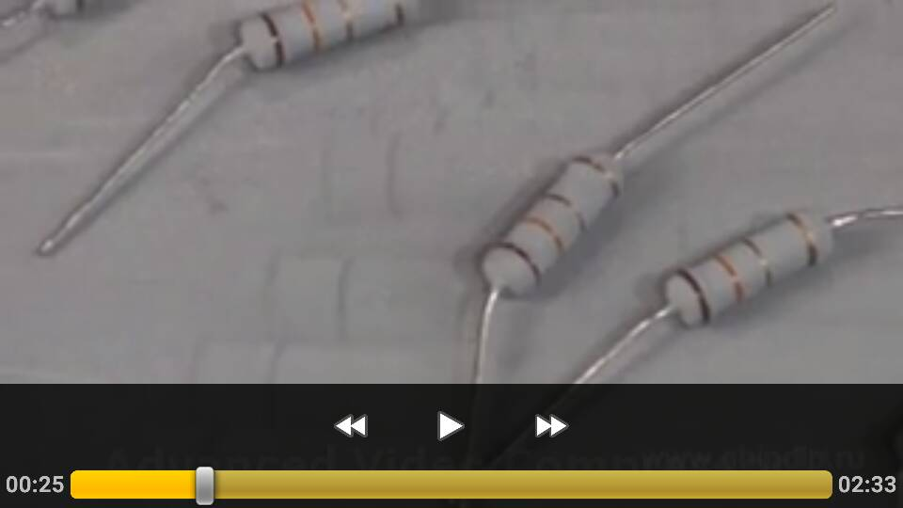
Video played with controls

Slide 15
Thank You

